Slide 1
Stream Control
Transmission Protocol
TCP/IP Protocol Suite

Slide 2
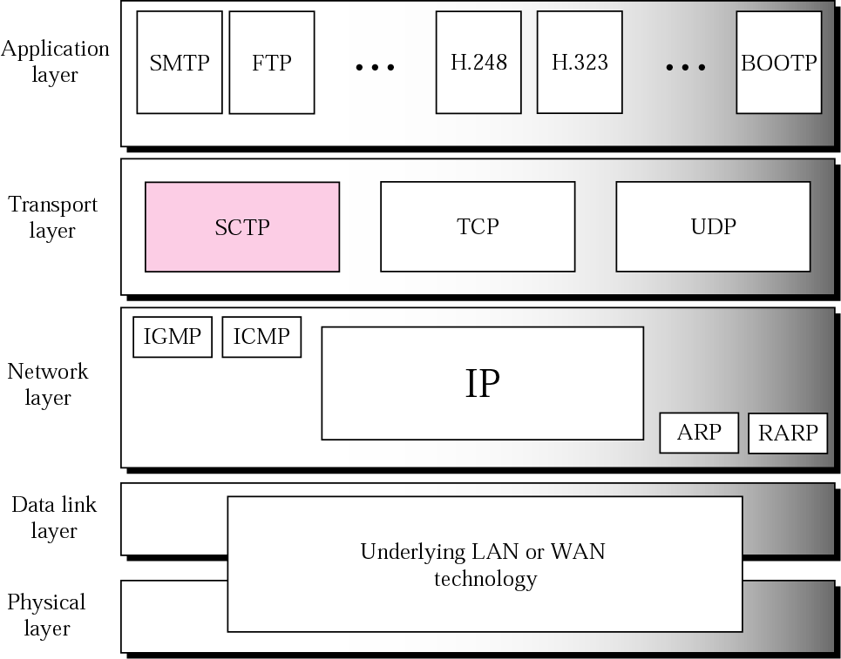
Figure 13.1 TCP/IP protocol suite
TCP/IP Protocol Suite

Slide 3
Introduction
Stream Control Transmission Protocol (SCTP) is a new reliable, message-oriented transport-layer protocol.
SCTP combines the best features of UDP and TCP.
SCTP is a reliable message oriented protocol. (UDP)
It preserves the message boundaries and at the same time detects lost data, duplicate data, and out-of-order data. (TCP)
It also has congestion control and flow control mechanisms.(TCP)
TCP/IP Protocol Suite

Slide 4
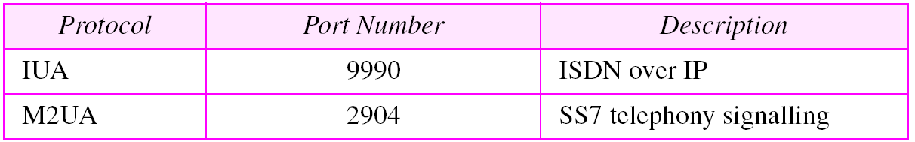
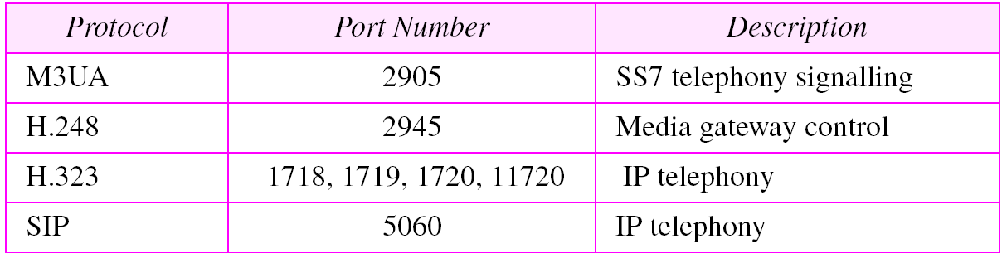
SCTP Services
Process to process Communication
  SCTP uses all well known ports in TCP space
TCP/IP Protocol Suite

Slide 5
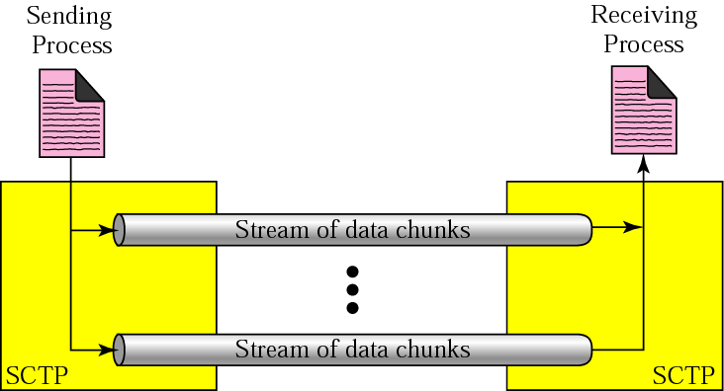
Figure 13.2 Multiple-stream concept
Multiple Streams
TCP/IP Protocol Suite

Slide 6
Multiple Streams
SCTP allows multistream service in each connection, which is called association in SCTP terminology.
If one of the streams is blocked, the other streams can still deliver their data.
TCP/IP Protocol Suite

Slide 7
Multihoming
The sending and receiving host can define multiple IP addresses in each end for an association.
In this, when one path fails, another interface can be used for data delivery without interruption.
This fault-tolerant feature is very helpful when we are sending and receiving a real-time payload such as Internet telephony.
TCP/IP Protocol Suite

Slide 8
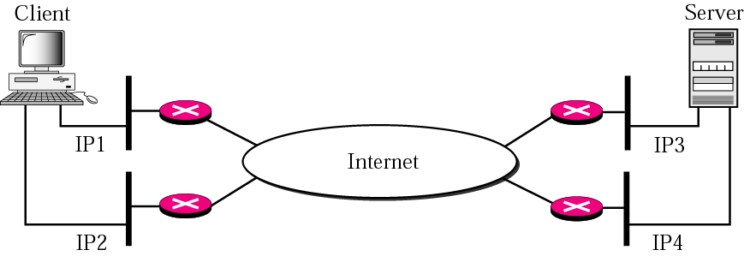
Figure 13.3 Multihoming concept
Note:
In current implementation of SCTP, only one pair of IP addresses can be chosen for normal communication; the alternative is used if the main choice fails.
SCTP does not allow load sharing between different paths.
TCP/IP Protocol Suite

Slide 9
SCTP Services
Full Duplex Communication
Connection oriented
Reliable Service
TCP/IP Protocol Suite

Slide 10
SCTP Features
Transmission Sequence number (TSN)
  Unit of data in SCTP is Data Chunks
  SCTP uses TSN to number data chunks.
  TSN is 32 bit long, randomly initialized between 0 to 2³²-1
  Each data chunk must carry the corresponding TSN in its header
TCP/IP Protocol Suite

Slide 11
SCTP Features
Stream Identifier (SI)
  In SCTP, there may be several streams in each association.
  Each stream in SCTP needs to be identified using a stream identifier (SI).
  To distinguish between different streams, SCTP uses an SI.
TCP/IP Protocol Suite

Slide 12
SCTP Features
Stream Sequence Number (SSN)
  To distinguish between different data chunks belonging to the same stream, SCTP uses SSNs.
Packets
  In SCTP, data are carried as data chunks, control information as control chunks.
  Several control chunks and data chunks can be packed together in a packet.
  TCP has segments; SCTP has packets.
TCP/IP Protocol Suite

Slide 13
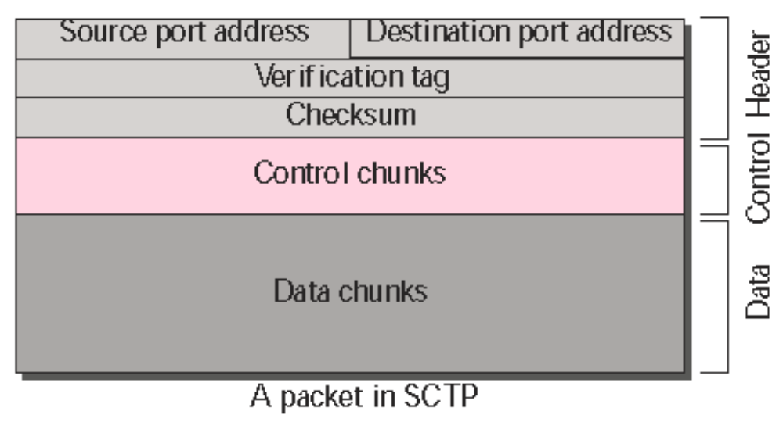
SCTP Packet
12 Bytes
TCP/IP Protocol Suite

Slide 14
An association may send many packets, a packet may contain several chunks, and chunks may belong to different streams.
TCP/IP Protocol Suite

Slide 15
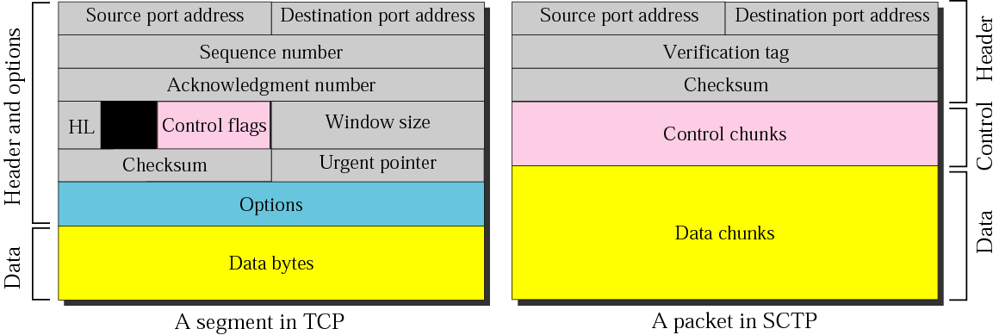
Figure 13.4 Comparison between a TCP segment and an SCTP packet
TCP/IP Protocol Suite

Slide 16
Example
Process A -------------------------- > Process B
11 messages in three streams.
First four messages are in the first stream, second three messages are in the second stream, last four messages are in the third stream.
Assume that each message fits into one data chunk.
Therefore, we have 11 data chunks in three streams.
only three data chunks per packet - four packets
TCP/IP Protocol Suite

Slide 17
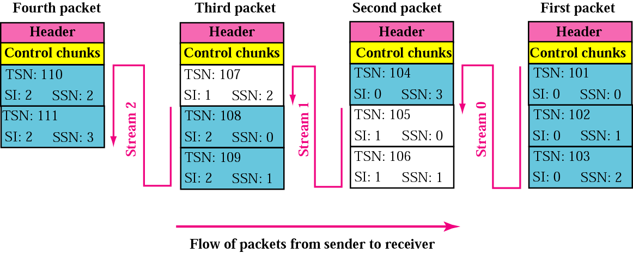
Figure 13.5 Packet, data chunks, and streams
TCP/IP Protocol Suite

Slide 18
NOTE:
Data chunks are identified by three identifiers: TSN, SI, and SSN.
TSN is a cumulative number identifying the association;
SI defines the stream;
SSN defines the chunk in a stream.
In SCTP, acknowledgment numbers are used to acknowledge only data chunks;
Control chunks are acknowledged by other control chunks if necessary.

Slide 19
SCTP PACKET FORMAT
TCP/IP Protocol Suite

Slide 20
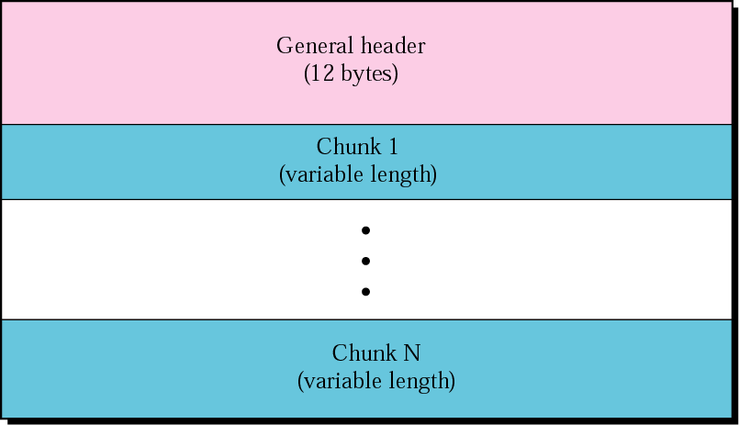
Figure 13.6 SCTP packet format
TCP/IP Protocol Suite

Slide 21
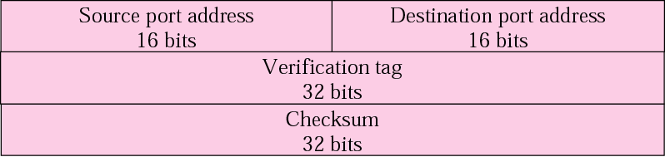
Figure 13.7 General header
Verification Tag :
Number that matches a packet to an association.
Serves as an identifier for the association and repeated in every packet during association.
TCP/IP Protocol Suite

Slide 22
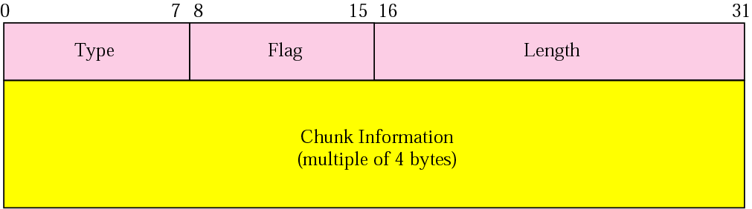
Figure 13.8 Common layout of a chunk
Type : Defines 256 types of chunks
Flag : Defines special flags that a particular chunk may need.
Length :
  Total Length of chunk includes Type, Flag and Length.
  Length of padding not included in calculation
  If not multiple of 4, receiver knows there is padding.

Slide 23
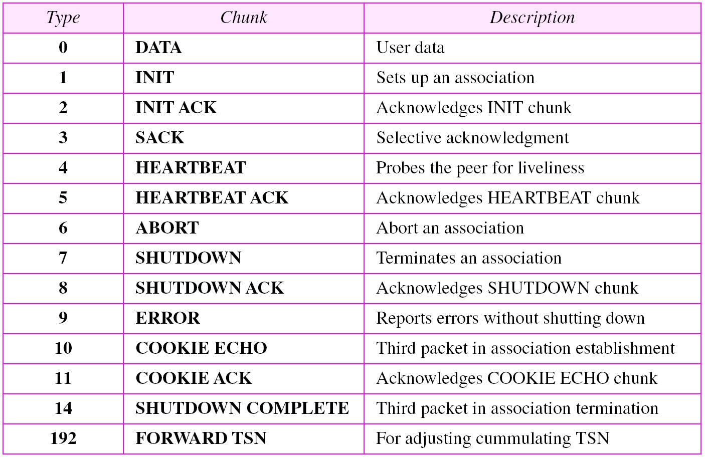
Table 13.2 Chunks
TCP/IP Protocol Suite

Slide 24
AN SCTP ASSOCIATION
TCP/IP Protocol Suite

Slide 25
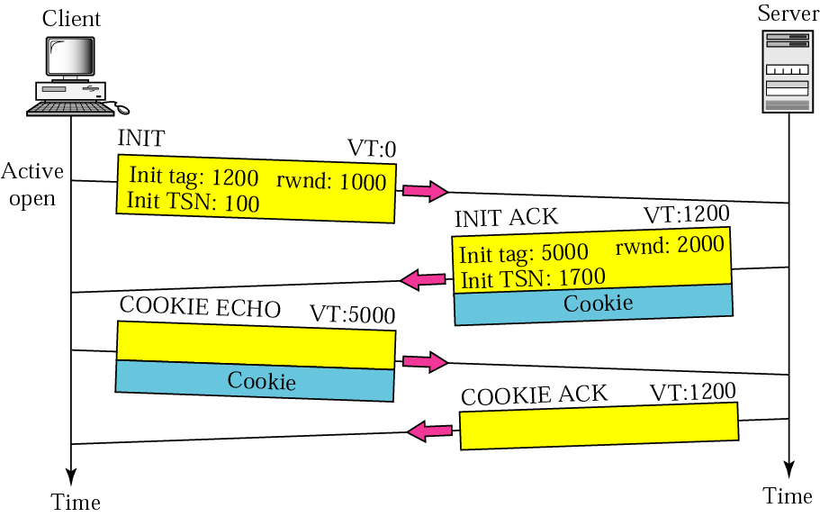
Figure 13.19 Four-way handshaking
Association Establishment :
Cookie carry state of server

Slide 26
NOTE:
No other chunk is allowed in a packet carrying an INIT or INIT ACK chunk.
A COOKIE ECHO or a COOKIE ACK chunk can carry DATA chunks.
In SCTP, only DATA chunks consume TSNs;
DATA chunks are the only chunks that are acknowledged.
TCP/IP Protocol Suite

Slide 27
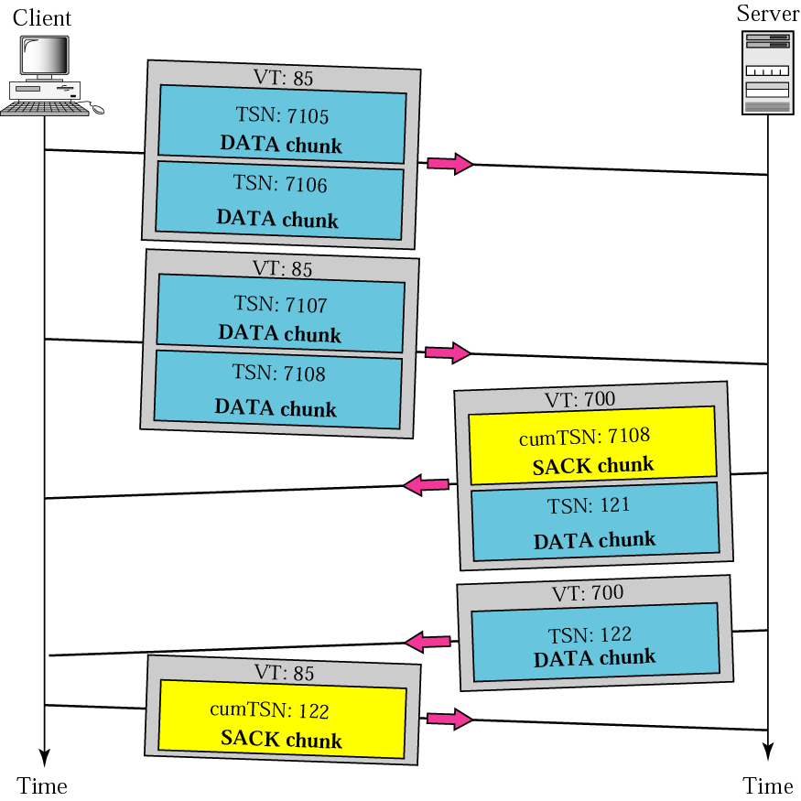
Figure 13.20 Simple data transfer
TCP/IP Protocol Suite

Slide 28
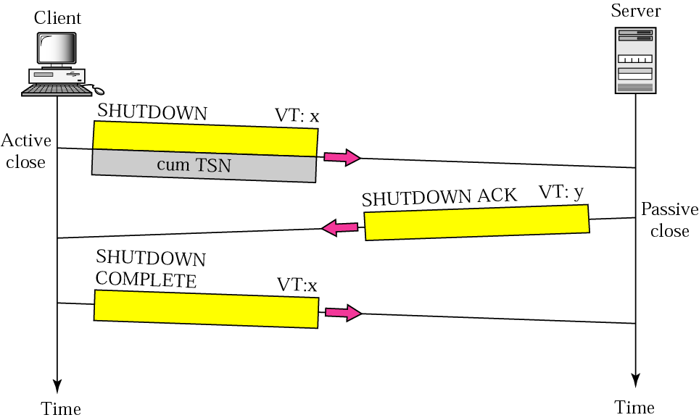
Figure 13.21 Association termination
TCP/IP Protocol Suite

